Slide 1
Variables & Data types
Programming dnyan

Slide 2
What is Variable ?
Variables are storage containers which is used to store specified value.
In variables are stored value respectively to data type.

Slide 3
What are data types ?
Each variable in C has an associated data type. Each data type requires different amounts of memory and has some specific operations which can be performed over it.

Slide 4
List of Data types commonly used
char: The most basic data type in C. It stores a single character and requires a single byte of memory in almost all compilers.
int: As the name suggests, an int variable is used to store an integer.
float: It is used to store decimal numbers (numbers with floating point value) with single precision.
double: It is used to store decimal numbers (numbers with floating point value) with double precision.

Slide 5
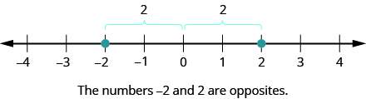
Sets of Integer
A signed integer is an integer that can be both positive and negative. This is as opposed to an unsigned integer, which can only be positive.
Range of int = -2,147,483,648 to 2,147,483,647

Slide 6
Memory of data types
Int – 4 bytes
Char – 1 byte
Float – 4 bytes
Double – 8 bytes

Slide 7
What is Format specifiers
The format specifier is used during input and output. It is a way to tell the compiler what type of data is in a variable during taking input using scanf() or printing using printf()

Slide 8
Format specifiers
Int - %d
Float - %f
Double - %lf
Char - %c

